Slide 1
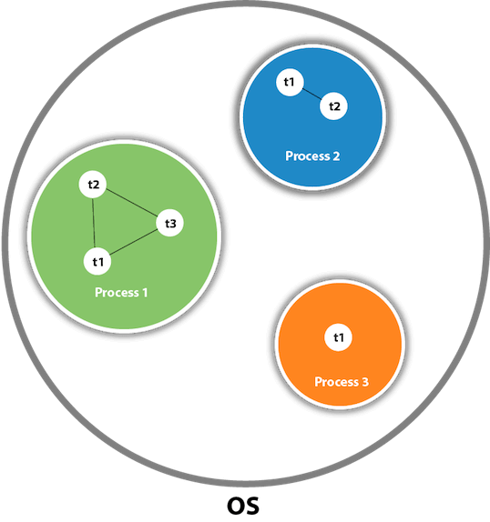
Java Threads
Threads - is a lightweight sub-process, the smallest unit of processing. Multiprocessing and multithreading, both are used to achieve multitasking.
Creation
By implementing Runnable Interface.
By extending Thread class.

Slide 2
Advantages of Java Multithreading
It doesn't block the user because threads are independent and you can perform multiple operations at the same time.
You can perform many operations together, so it saves time.
Threads are independent, so it doesn't affect other threads if an exception occurs in a single thread.

Slide 3
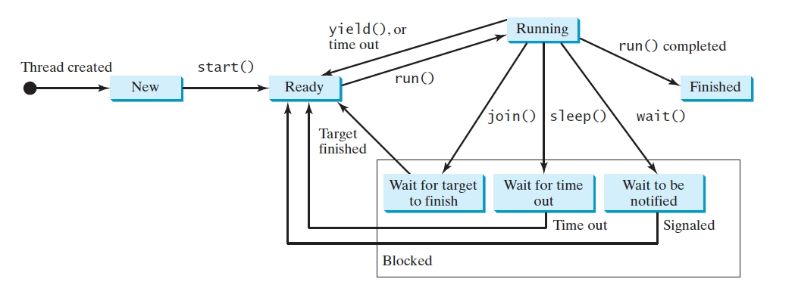
Thread’s Life Cycle
join() - waits for this thread to finish.
sleep() - puts a thread to sleep for a specified .
yield() - causes a thread to pause temporarily and allow other threads to execute.
Depricated: stop(), suspend() and resume().
You should assign null to a Thread variable to indicate that has stopped.

Slide 4
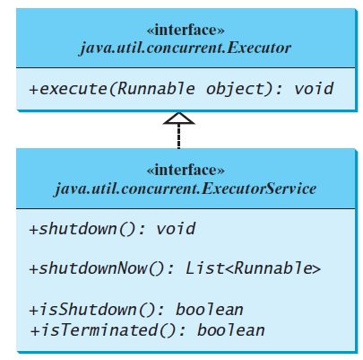
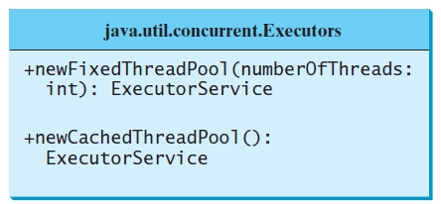
Thread Pool
Advantages:
Starting a new thread for each task could limit throughput and cause poor performance.
Using a thread pool is an ideal way to manage the number of tasks executing concurrently.
Java provides the Executor interface for executing tasks in a thread pool and the ExecutorService interface for managing and controlling tasks. ExecutorService is a subinterface of Executor

Slide 5

Daemon Thread
Thread Priority
Each thread have a priority. Priorities are represented by a number between 1 and 10. priority knowns as primitive scheduling. But it is not guaranteed order of execution, because it depends on JVM specification that which scheduling it chooses.
public static int MIN_PRIORITY
public static int NORM_PRIORITY
public static int MAX_PRIORITY
Daemon thread in java is a service provider thread that provides services to the user thread. Its life depends on the mercy of user threads i.e. when all the user threads dies, JVM terminates this thread automatically.
What should we remember about daemon thread
It has no role in life than to serve user threads.
Its life depends on user threads.
It is a low priority thread.

Slide 6
Thread Synchronization
Thread synchronization is to coordinate the execution of the dependent threads. You can use the keyword synchronized
to synchronize the method so that only one thread can access the method at a time.
Advantages:
To prevent thread interference.
To prevent consistency problem.
There are two types of thread synchronization mutual exclusive and inter-thread communication.
1. Mutual Exclusive
Synchronized method.
Synchronized block.
static synchronization.
2. Cooperation (Inter-thread communication in java)

Slide 7
Inter-thread communication or Co-operation
Inter-thread communication is a mechanism in which a thread is paused running in its critical section and another thread is allowed to enter (or lock) in the same critical section to be executed. It is implemented by following methods of Object:
wait() - tells the calling thread to give up the lock and go to sleep until some other thread enters the same monitor and calls notify()
notify() - wakes up a single thread that is waiting on this object's monitor.
notifyAll() - wakes up all threads that are waiting on this object's monitor.

Slide 8
Source:
https://www.javatpoint.com/multithreading-in-java
Y.Daniel Liang “Introduction to JAVA programming 9th Edition”
Source code and samples:
https://github.com/usb777/Java_Threads.git

